Slide 1
DRINCDynamically Refreshing Interplexing Numbers of Cordials
Brandon Arnold
Owen Ledvina
Hoang Phan
Kyle Timins
Notes:
Introduce ourselves

Slide 2
Introduction
What is DRINC?
Interfaces
Server
Pouring Device
Notes:
Brandon: I’m a cozy public speaker, so I can do generalized slides too if people want.

Slide 3
Functional Requirements
Hardware
Software
Notes:
Speaker: Owen

Slide 4
Hardware
Frame: Must hold:
9 liter sized glass bottles, control systems, transport track
Power Supply:
Be able to power all systems in the DRINC
Back End Control Systems:
Be able to control all mixing hardware with one microprocessor
Be able to run main system on one microprocessor and interact with
other microprocessor
Notes:
Speaker: Owen

Slide 5
Hardware - cont...
Drink Transport Track:
Transport cup safely, securely, and accurately on a square grid
Track Servos:
Two servos strong enough to move a full pint of liquid and glass
reliably
Valves:
Installed on each bottle
Ability to turn on and off quickly by backend system to pour ~40ml parts
Notes:
Speaker: Owen

Slide 6
Software
Website:
Log on and off authentication using backend database
After successful authentication, user is presented with a menu:
Create a Custom Drink
Select a Drink
Most Drank
Delete a Drink
Notes:
Speaker: Kyle

Slide 7
Software - cont...
Backend Server:
Hold drink information and send to DRINC
Ability to SSH into machine for maintenance or configuration
Keep track of the drinks consumed by the user during time period
Notes:
Speaker: Brandon

Slide 8
Nonfunctional Requirements
Valves:
Should be made of plastic or non-copper alloy metal
Frame:
Should be modular and easily disassemblable
Server:
Should be able to handle all login and logout requests in under 200ms
The server information must be backed up every Wednesday, at 9:00AM
Notes:
Split up

Slide 9
Interfaces
Web Site:
Should allow the user to do any task in the least amount of clicks
Should look visually appealing, with lack of “clutter”
Android:
Should look very similar to the website
Will allow the user to log in via a wireless technology
Notes:
Speaker: Kyle

Slide 10
Website
HTML, PHP, CSS, Javascript
PostgreSQL
Administrative functions
Notes:
Speaker: Kyle

Slide 11
Android Device
Nexus 7
App will be built in the Android version of Java
Device will be attached to the DRINC machine
Notes:
Speaker: Hoang

Slide 12
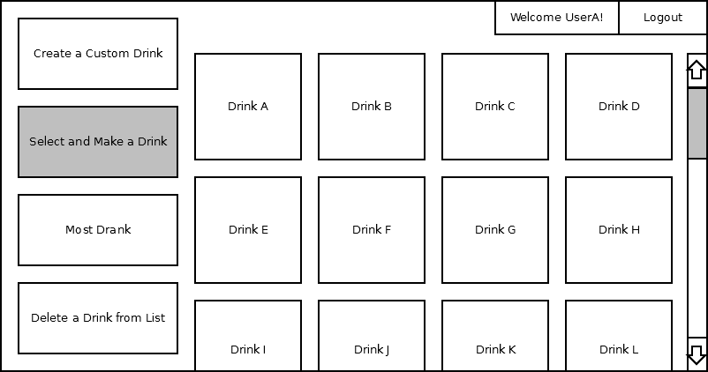
Android Mock-up
Notes:
Speaker: Hoang

Slide 13
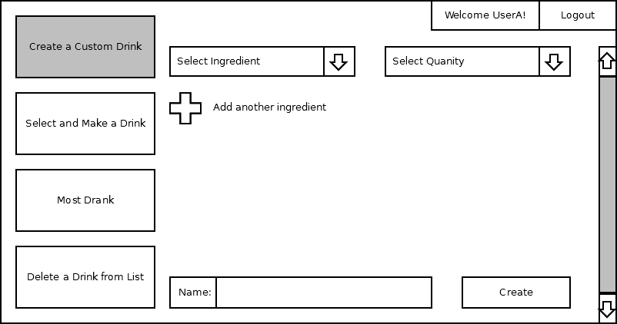
Android Mock-up
Notes:
Speaker: Hoang

Slide 14
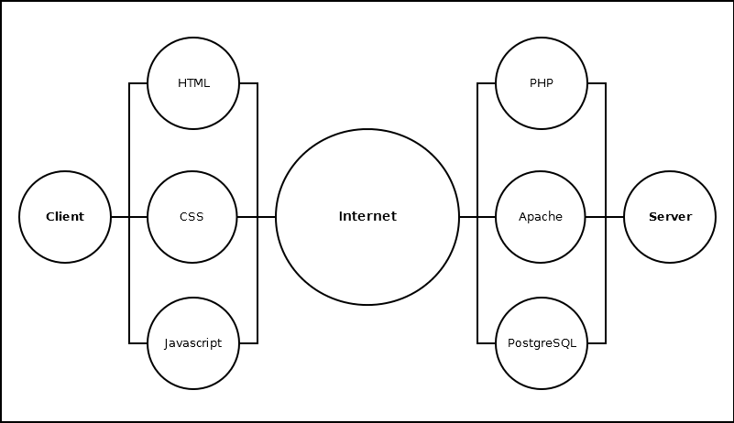
Notes:
Speakers: Begin with Hoang, transition over to Brandon

Slide 15
Server
The server will be a Raspberry Pi, with the following specs:
Processor: Broadcom 700 MHz
RAM: 512MB
Graphics: VideoCore IV
Hard Drive: 8GB SD Card
OS: Debian Linux (Raspian)
Notes:
Speaker: Brandon

Slide 16
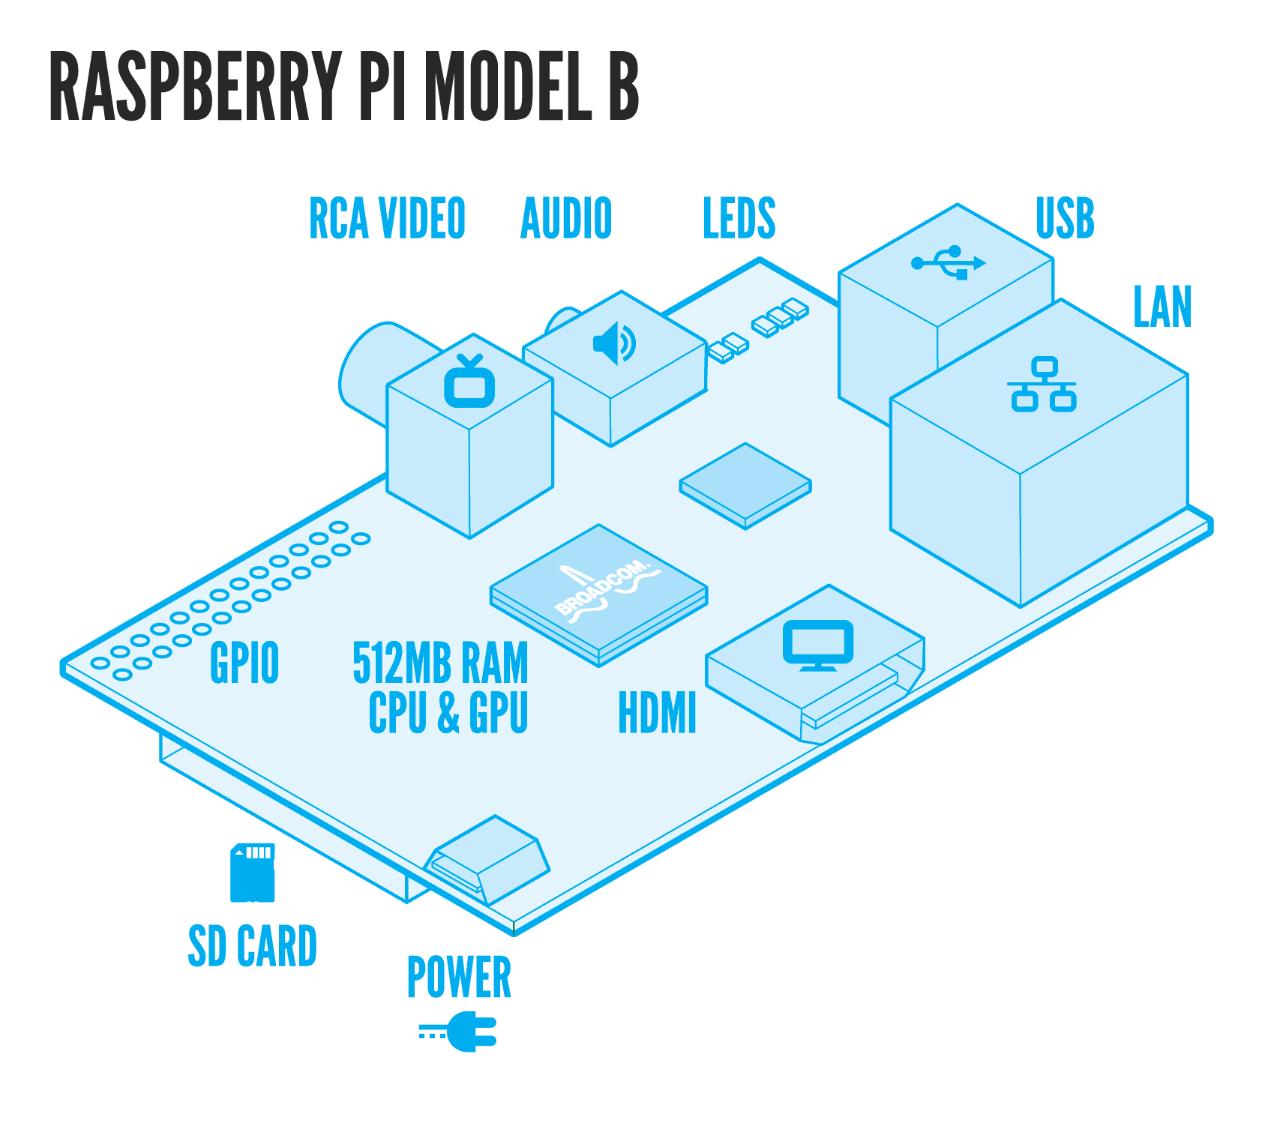
Notes:
Speaker: Brandon

Slide 17
Server Software
Raspian
Apache2
PostgreSQL
Notes:
Speaker: Brandon

Slide 18
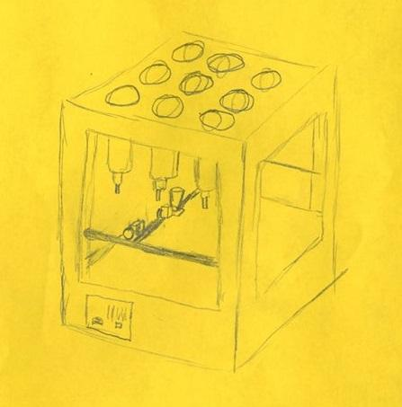
Hardware Mockup
Notes:
Speaker: Owen

Slide 19
What We’ve Done
-All teammates worked together on documentation.
-Hoang primarily worked on diagrams.
-Raspian installed
-Apache, postgreSQL installed.

Slide 20
Conclusion
Why DRINC?
Notes:
Speaker: Kyle

